Slide 1
Formal Methods
Lecture 2 and 3

Slide 2
Recap
Formal Methods

Slide 3
Logic
Logic is primarily a language to
model the system (program)
reason about the correctness or incorrectness of the system’s properties

Slide 4
Philosophical Logic
500 B.C - 19th Century
Logic dealt with reasoning of arguments in the natural language used by humans.
Abstract study of propositions and statements
Example: Valid Argument
All IIUI students are good at studies.
Ayesha is a IIUI student
Therefore, Ayesha is good at studies.

Slide 5
Philosophical Logic
If the train arrives late and there are no taxis at the station, then John is late for his meeting.
John is not late for his meeting.
The train did arrive late.
Therefore, there were taxis at the station.
Valid or Invalid?
- Valid (Combine 1, 2 and 3 and then use 4)

Slide 6
Philosophical Logic
Natural languages are very ambiguous.
Example:
Tom hates Jim and he likes Mary.
Tom likes Mary, or
Jim likes Mary
Thus, we need a more mathematical language for logical reasoning

Slide 7
Propositional Logic
A proposition - a sentence that can be either true or false.
Mr. Abid is teaching Formal Methods in this term
5 is greater than 4

Slide 8
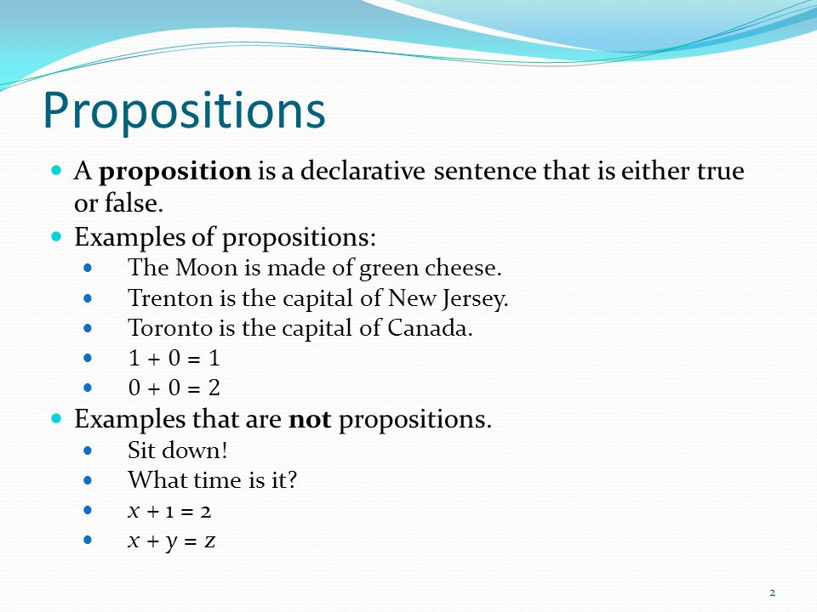

Slide 9
Activity: Identify Propositions
May fortune come your way.
F
Jane reacted violently to Jack’s accusations.
T
Every even natural number > 2 is the sum of two prime numbers.
T
Ready, steady, go.
F
Please pass me the salt and pizza.
F

Slide 10
Connectives in Propositional Logic
- ∧ and (conjunction):
a ∧ b: Both a and b are true.
or (disjunction)
a ∨ b: at least one of a or b are true
- ∨

Slide 11
Connectives in Propositional Logic
¬not (negation)
¬ a: a is not true
→ implication
a → b: if a then b (a: assumption, b: conclusion)
- ↔equivalent to
a ↔ b: a is equivalent to b, i.e., a → b ∧ b → a
- Ⱶ
therefore
⊥, T False,True

Slide 12
The Negation Operator
The unary negation operator “¬” (NOT) transforms a
prop. into its logical negation.
If p = “I have brown hair.”
then ¬p = “I do not have brown hair.”

Slide 13
Negation of p
Let p be a proposition. The statement “It is not the case that p” is also a proposition, called the “negation of p” or ¬p (read “not p”).
p = The sky is blue.
¬p = The sky is not blue.
The Truth Table for the
Negation of a
Proposition
p ¬p
T F
F T

Slide 14
Negation
For any proposition
(¬¬p) ⇔ p
(¬¬true) ⇔ true
(¬¬false) ⇔ false

Slide 15
Simple Exercise
Calculate the truth values of following propositions
¬(0<1)
¬(1+1=2)
¬(The earth revolves around the moon)

Slide 16
Conjunction Operator
The binary conjunction operator “∧” (AND) combines two propositions to form their logical conjunction.
If
p=“I will have salad for lunch.”
q=“I will have steak for dinner.”
then
p∧q=“I will have salad for lunch and I will have steak for dinner.”

Slide 17
Conjunction of p and q
The Truth Table for the Conjunction of two propositions
Let p and q be propositions.
The proposition “p and q,”
denoted by p∧q is true when
both p and q are true and is
false otherwise This is called
the conjunction of p and q.
p q p∧q
T T T
T F F
F T F
F F F

Slide 18
Truth Table
The truth table for p∧(¬q)
p | q | ¬q | p∧(¬q)
True | True | False | False
True | False | True | True
False | True | False | False
False | False | True | False

Slide 19
The Disjunction Operator
The binary disjunction operator “∨” (OR) combines two propositions to form their logical disjunction.
p=“That car has a bad engine.”
q=“That car has a bad carburetor.”
p∨q=“Either that car has a bad engine, or that car has a bad carburetor.”

Slide 20
Disjunction of p and q
Let p and q be propositions.
The proposition “p or q,” denoted by p∨q, is the proposition that is false when p and q are both false and true otherwise.
The Truth Table for the Disjunction of two propositions
p q p∨q
T T T
T F T
F T T
F F F

Slide 21
Symbols in Propositional Logic
Each proposition is assigned a symbol
‘x is greater than y.’: p
‘Mr. Abid is teaching Formal Methods this term’: q
‘I won a gold medal in last years Sports gala.’: r

Slide 22
Activity: Modeling with Propositional Logic
If the train arrives late and there are no taxis at the station, then John is late for his meeting.
John is not late for his meeting.
The train did arrive late.
Therefore, there were taxis at the station.

Slide 23
Activity: Modeling with Propositional Logic
If the train arrives late (p) and there are no taxis at the station (q), then John is late for his meeting (r).
- (p ∧ (¬ q ))→ r
John is not late for his meeting.
¬r
The train did arrive late.
p
Therefore, there were taxis at the station.
q
((p ∧ (¬ q)) → r) , (¬ r) , p Ⱶ q

Slide 24
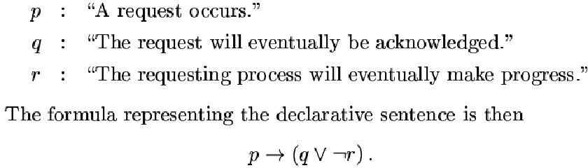
Activity: Modeling with Propositional Logic
If a request occurs, then either it will eventually be acknowledged, or the requesting process won’t ever be able to make progress.

